Slide 1


Exploring the interplay between CDN caching and video streaming performance
Ehab Ghabashneh, Sanjay Rao
Dong Hyeon Lee
Chung-Ang University
enjoying1018@naver.com
August. 5th 2021

Slide 2
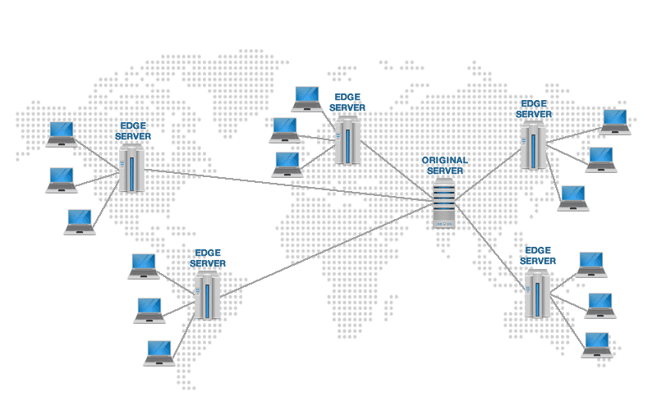
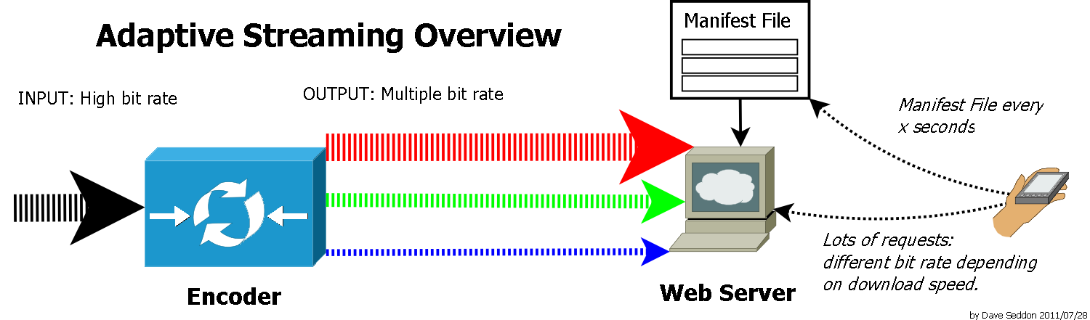
ABR(Adaptive Bit Rate)
CDN
Throughput-based algorithms
: measure the download speed of previous video chunks to determine which bitrate to choose next
Buffer-based algorithms(MPC)
: control the buffer occupancy to ensure there’s always enough video ready for playback

Slide 3
questions to solve
Where in a CDN hierarchy are objects in a video session served from? Is the treatment of video chunks with a session homogeneous, or are there variations within a session?
What is the impact of where objects are served from by a CDN on video streaming performance?

Slide 4
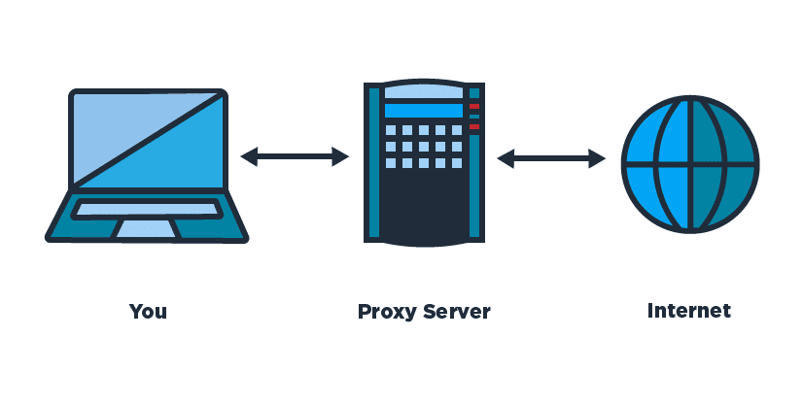
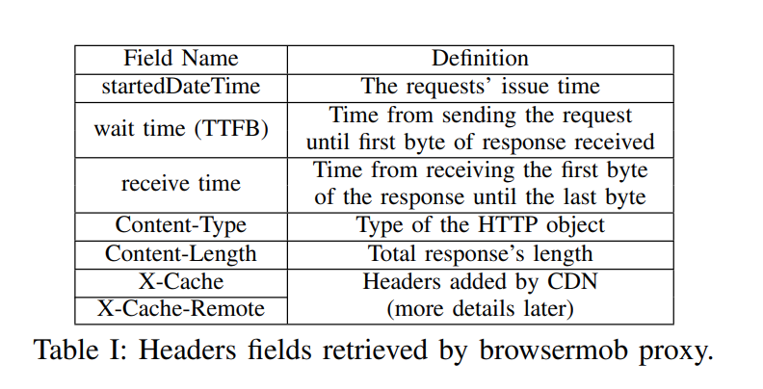
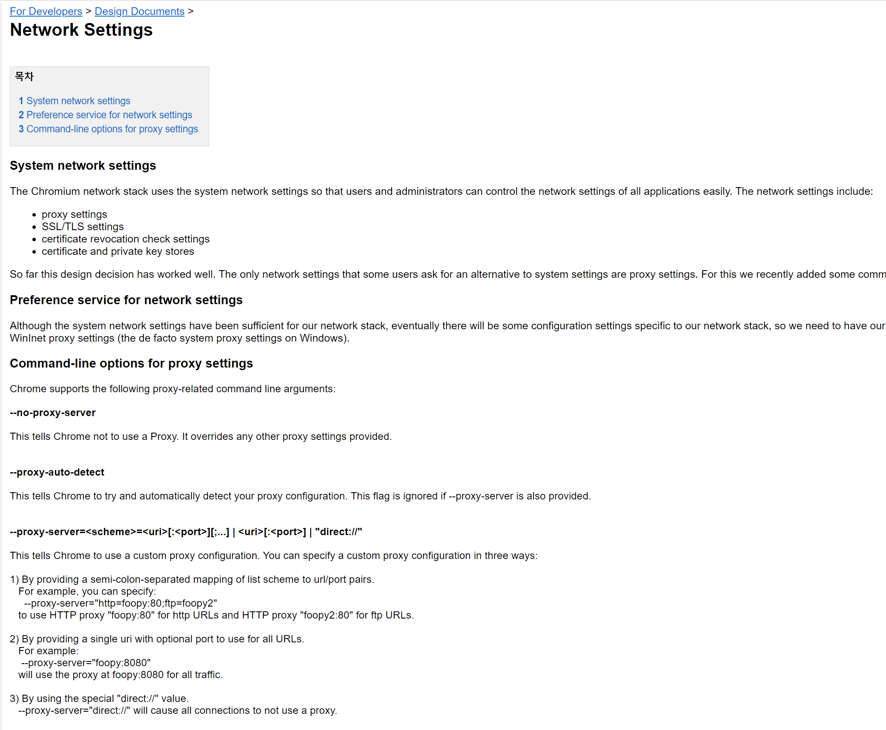
How to measure?
2 publishers(twich, vimeo) + 4 different locations(home 2 + university 1 + business location 1)
3 type of CDN(Akamai, Fastly, CloudFront)
Two sets of data:
ABR-Set(twitch, vimeo)
4K-Set=no ABR, only 4K Video
Use Chrome using the –proxy-server flag.
Proxy archives relevant header of HTTP request.

Slide 5
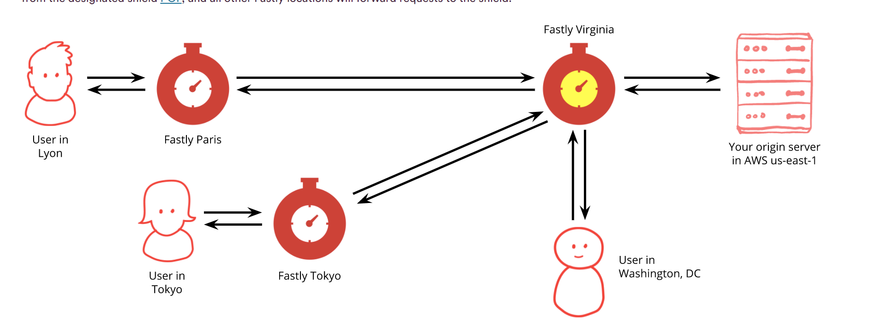
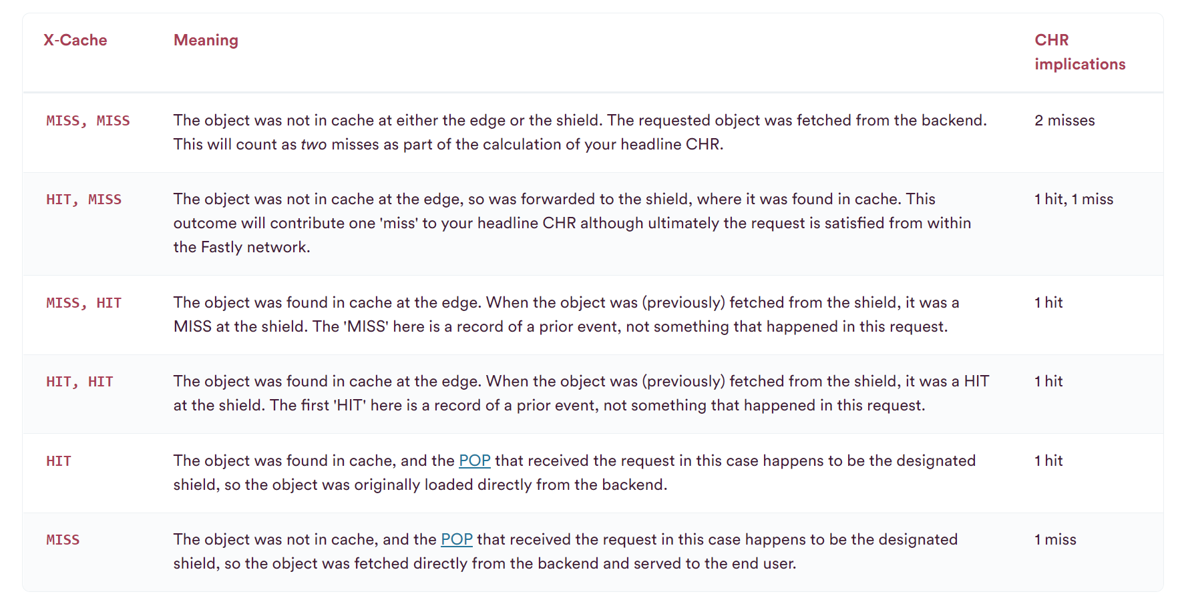
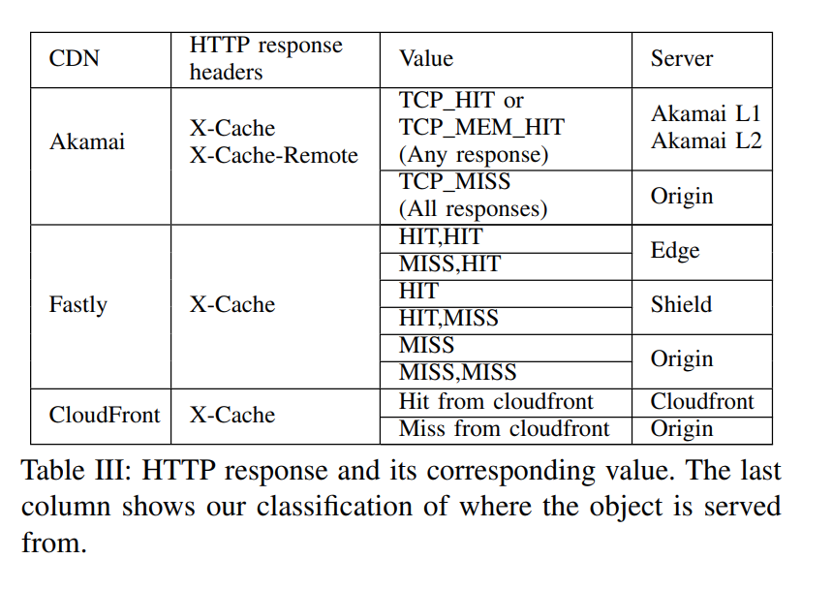
How to measure?

Slide 6
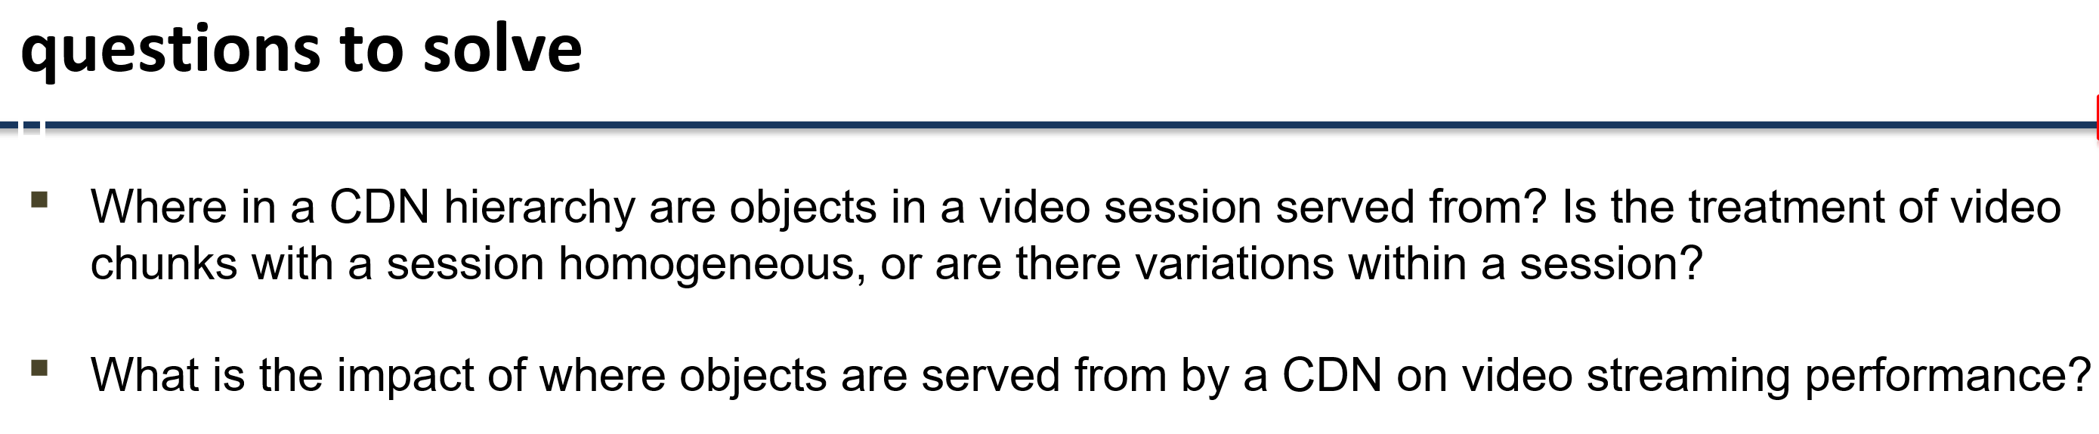
What measured?
Time to First Byte(TTFB): request 보냄 ~ 첫 바이트 수신 까지의 시간
Network Throughput: chunk size / 첫 바이트 수신~ 마지막 바이트 수신 의 시간
Application Throughput: chunk size / request 보냄 ~ 마지막 바이트 수신의 시간

Slide 7
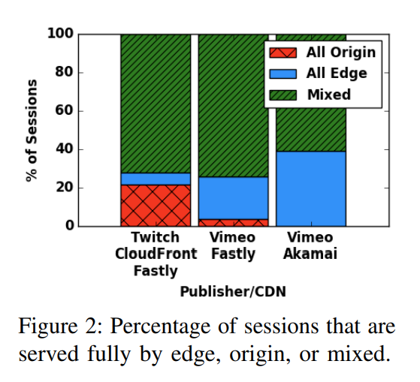
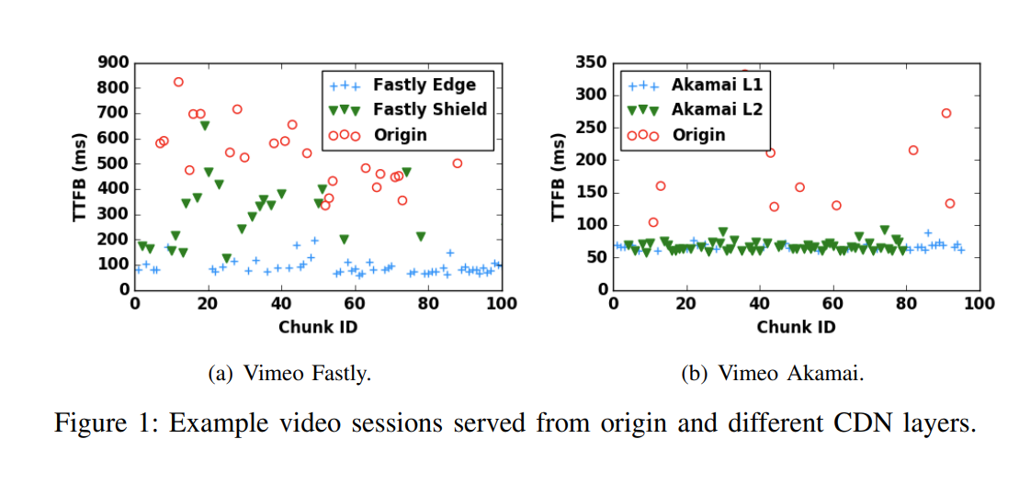
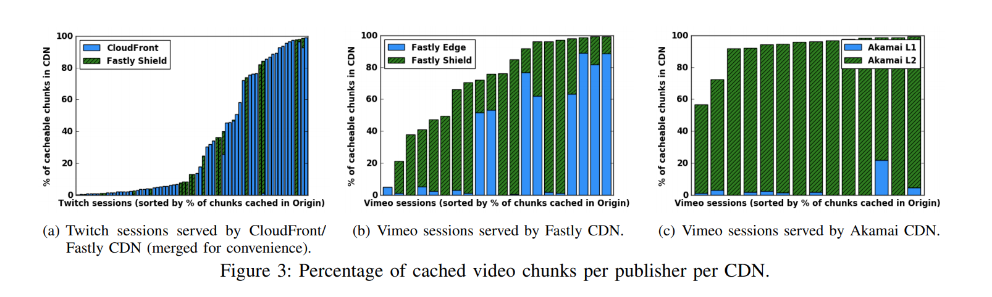
Figure 1~3

Slide 8
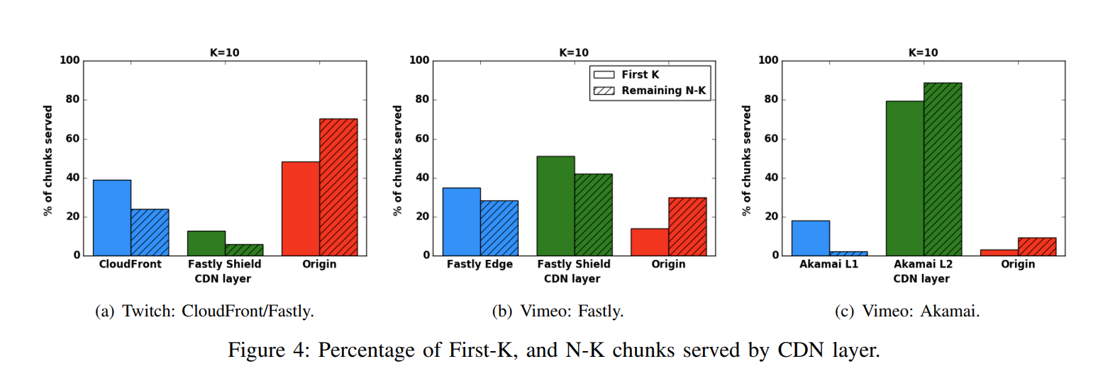
Figure 4: same video, different layer?
33% of users abandon video sessions within 30 seconds if not interested.

Slide 9
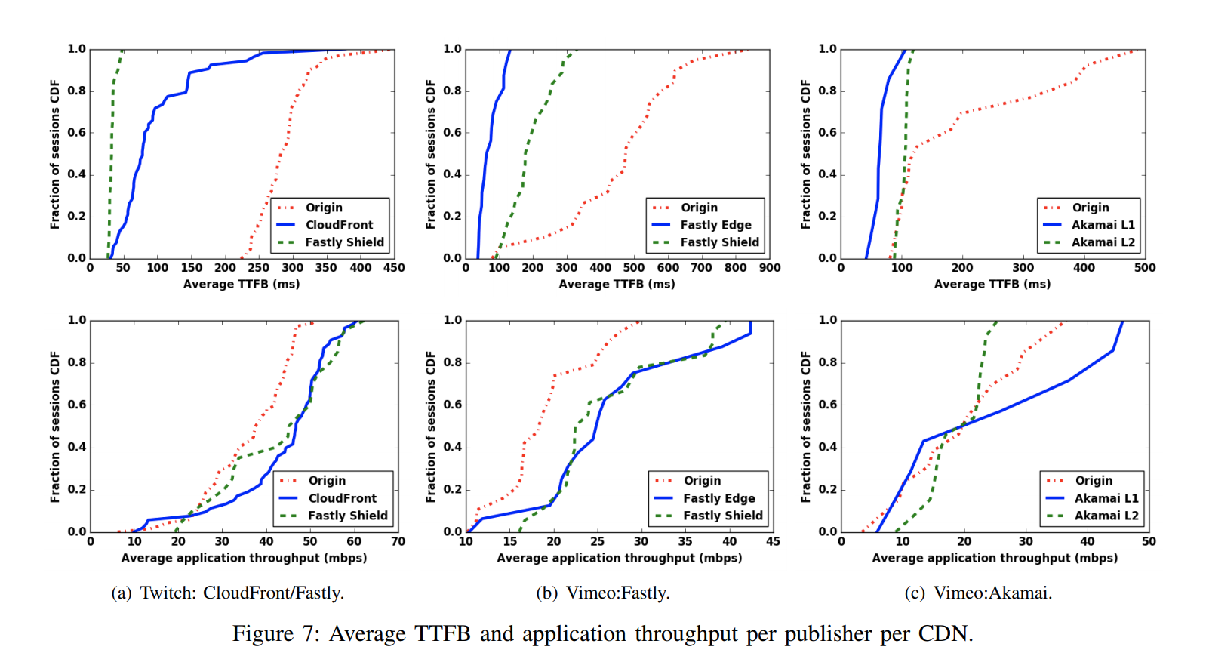
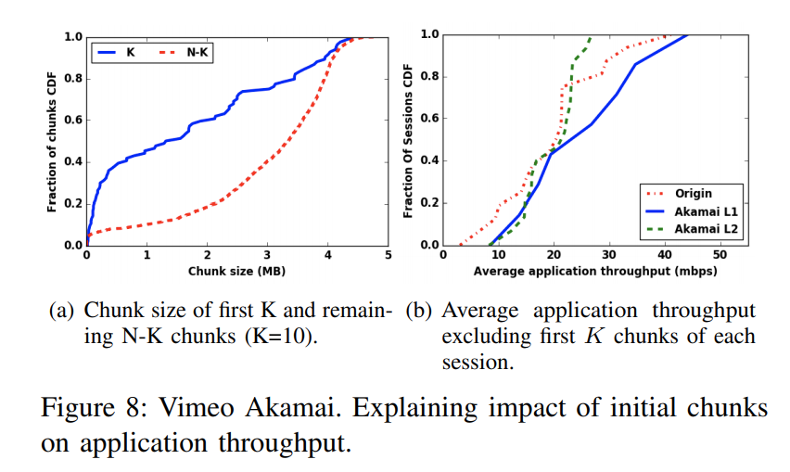
Figure 7

Slide 10
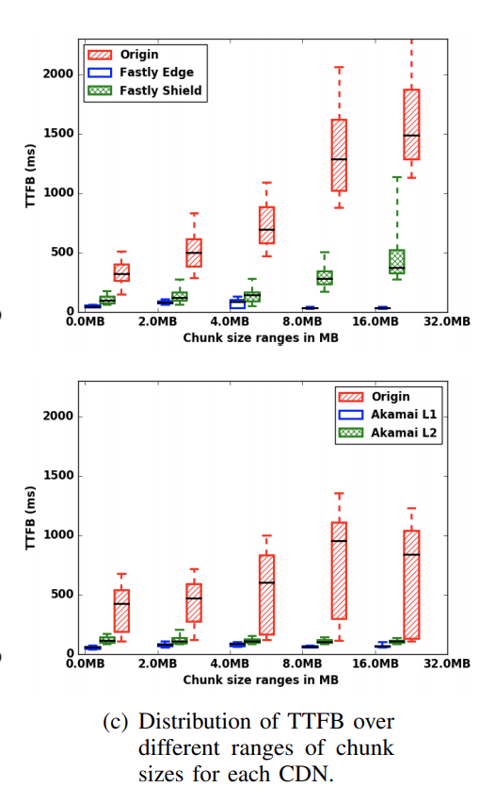
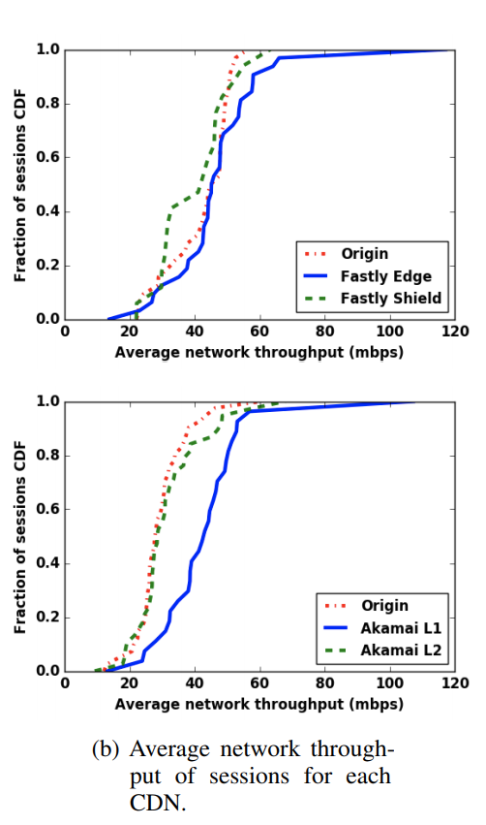
Figure 9(4K)
Because of streaming miss optimization!
Akamai have streaming miss optimization.
Network Throughput: chunk size / 첫 바이트 수신~ 마지막 바이트 수신 의 시간

Slide 11
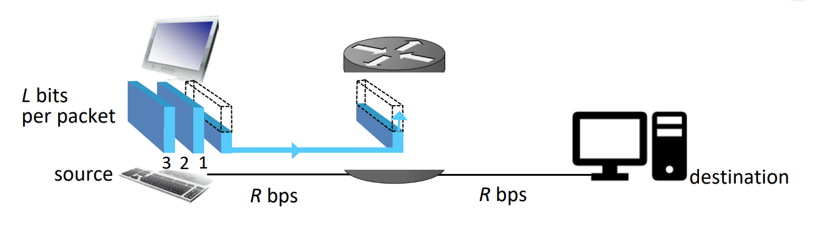
streaming miss optimization
Store-and-forward
Network Throughput:
chunk size / 첫 바이트 수신~ 마지막 바이트 수신 의 시간

Slide 12
NEW ABR Algorithm: add CDN awareness
Current ABR algorithm is agnostic of whether chunks are served from the origin, or the CDN.
→separately maintain the past throughput and prediction errors for chunks served from the CDN and origin.
→include a hint that indicates whether the next chunk is served from the CDN or the origin.
<experiment>
Used chromium, dash.js
635 seconds of video
Encode the video [720p, 1080p, 1440p, 2160p]
Bit rate [9194,15501,25243,52142] (kbps, google recommend)
Used Mahimahi framework(simulation)
= Run client, server on the same computer
*laptop info
3.5GHz quad-core processor, 16GB of RAM, and NVIDIA GeForce GTX 960M GPU

Slide 13
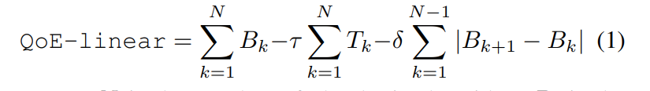
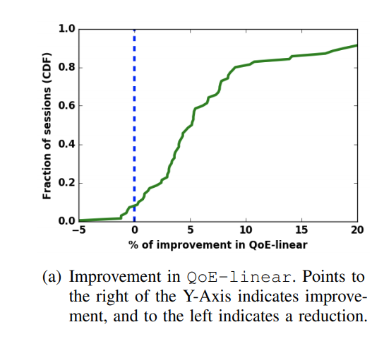
NEW ABR Algorithm: Evaluation
(단위:Mbps)
52.142
1(default)

Slide 14
Extra(discussion)

Slide 15
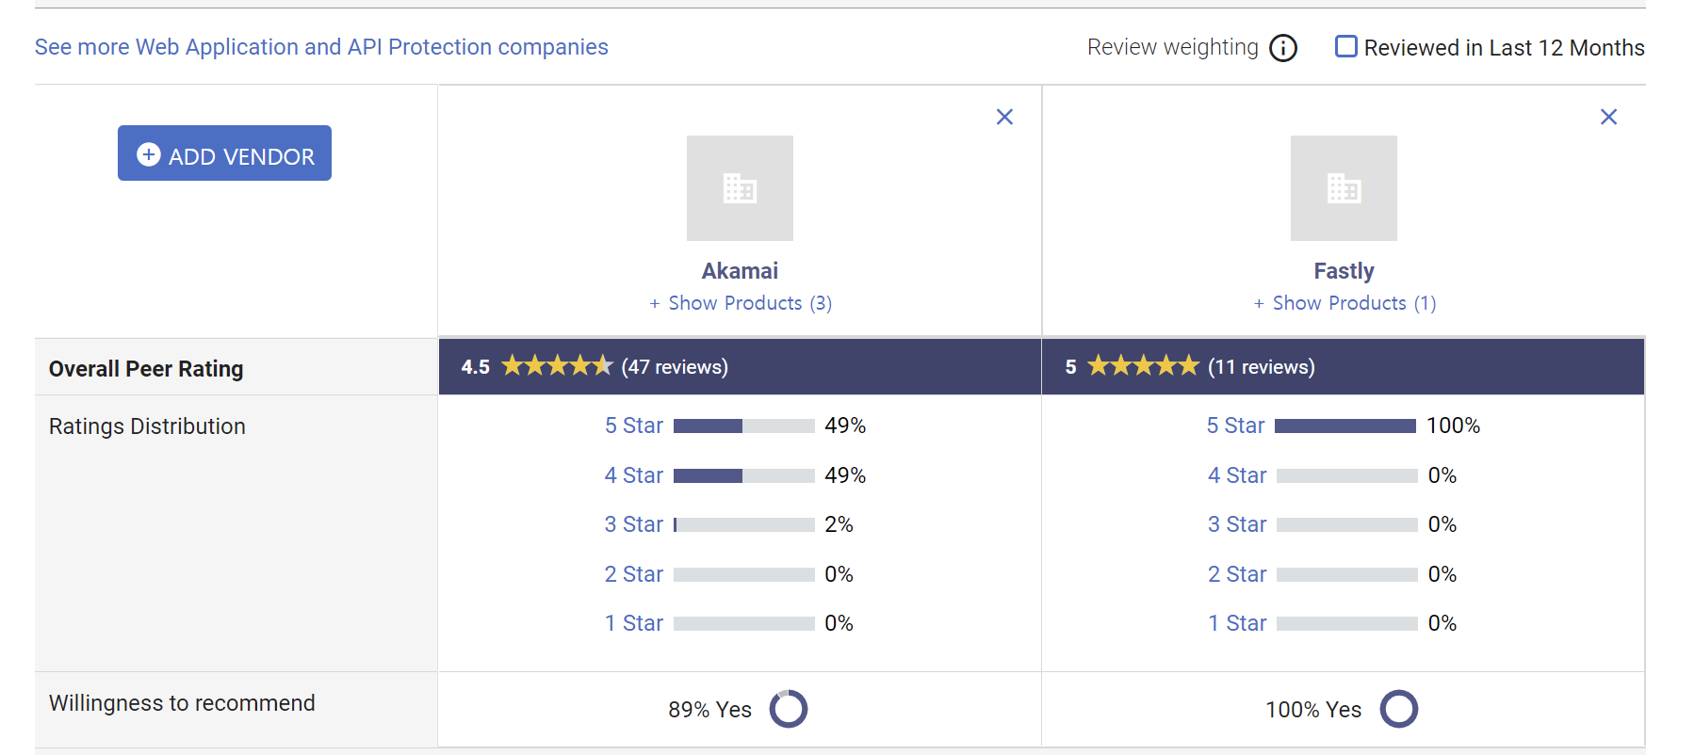
Extra(discussion) : akamai > fastly?

Slide 16



Thank you!

